Slide 1
Predicting Collision Severity
Project Report

Slide 2

Introduction/Business Problem

Slide 3



Business Understanding
Problem Statement
The number of vehicular accidents in US are increasing each day. It is becoming increasingly difficult for govt authorities to identify, track, and prevent the accidents at a granular level. Identifying the severity of the damage is a manual process, where a person/official analyses the accident zone physically present and classifies it for further down stream processes.
Our Solution
Given the historical accident information available at a granular level (explained in next slide), we would like to use artificial intelligence to predict the severity of the damage occurred. This information will be utilized downstream for many processes such as –
Stakeholders
Insurance agencies
Govt Agencies (Police)
General public awareness
faster and accurate claim processing
Police officials to monitor the high risk areas/zones
accident prone areas and necessary precautions

Slide 4
How the Solution helps
Stakeholder
Use case
Benefit
Accidental/damage information is quintessential for insurance agencies to accurately process claims in very short time
Faster claims resolution
Low loss/frauds in claims
Better customer Exp
Insurance agencies
Govt agencies would need the data for social monitoring activities and targeted policing. Efficient utilization of Govt resources lead to less crime/accidents.
Efficient utilization of resources
Low crime rate
Increased social monitoring
Govt Agencies (Police)
Augmenting the zonal accidental data to apps like GMaps will help the mass public to drive safely and increased awareness towards safety
Reduced accidents
Increased public awareness
Increased customer exp
Mass Public Apps (GMaps)

Slide 5
Data Section

Slide 6
Data Understanding
Data Source – ARCGIS (IBM Course)
Data Set Basics
Title | Collisions—All Years
Abstract | All collisions provided by SPD and recorded by Traffic Records.
Description | This includes all types of collisions. Collisions will display at the intersection or mid-block of a segment. Timeframe: 2004 to Present.
Update Frequency | Weekly
Data Set Size | 194674 records
Features/Attributes | 37
Feature types | Multi-modal (int, Float, String, Object, Data time, etc.)

Slide 7
Data Cleaning and Pre-processing
Data Cleaning
Data Wrangling
Pre-processing
Drop features based on domain understanding
23 features dropped
Dropped features are primarily: keys/identifiers, state assigned codes, casual codes, descriptions, Geometry fields
Renaming Columns for readability and simplicity
4 feature names renamed
Missing value treatment
Identification of NA/Nulls
Removal of insignificant rows having missing values
Mean value replacement (non-categorical)
Type casting treatment
Date time conversion and extracting ‘day of week’ and ‘month’ features
Object to Int or Float
Converting categorical variables to Numerical/Dummies
6 features converted
Removing insignificant values of an variable based on histogram distributions (visualization)
‘Unknowns’ values of 2 variables are removed
Normalization of features
Train-test split of data
80% train and 20% test data

Slide 8
Feature Selection
Feature Kept | Features Removed | Reasoning
SHAPE , ADDRTYPE , SEVERITYCODE, COLLISIONTYPE , PERSONCOUNT , PEDCOUNT , PEDCYLCOUNT , VEHCOUNT , INJURIES , SERIOUSINJURIES , FATALITIES , INCDTTM , JUNCTIONTYPE , INATTENTIONIND , UNDERINFL , WEATHER , ROADCOND , LIGHTCOND | OBJECTID, INCKEY, COLDETKEY, INTKEY, , SEGLANEKEY , CROSSWALKKEY | Unique identifiers for the row; not very useful
 | EXCEPTRSNCODE, ST_COLCODE , SDOT_COLCODE , EXCEPTRSNCODE | Special unique codes which are better explained by other variables
 | EXCEPTRSNDESC , LOCATION , SEVERITYDESC, SDOT_COLDESC, ST_COLDESC | Textual variables (text analysis out of scope)
 | HITPARKEDCAR , SPEEDING, PEDROWNOTGRNT, SDOTCOLNUM, INCDATE | Y/N type of variables with Incomplete/large number of missing values

Slide 9
Methodology

Slide 10
Exploratory Data Analysis
Dependent Variable Distribution
Categorical Variables vs Dependent Variables

Slide 11
Data Modelling
Train Set (80% of dataset size)
Test Set (20 % of dataset size)
KNN Classifier
Decision Tree Classifier
SVM Classifier
Logistic Regression
K = 8
Max depth = 4
Criterion = ‘Entropy’
Kernel = ‘rbf’
C=0.01
Solver='liblinear'
Iterated the KNN classifier for best K (max accuracy)
Fit a decision tree with depth of 4 for optimum accuracy
SVM is in-efficient for large data sets.
Fit a logistic regression classifier with liblinear solver and C = 0.01

Slide 12
Evaluation and Conclusion

Slide 13
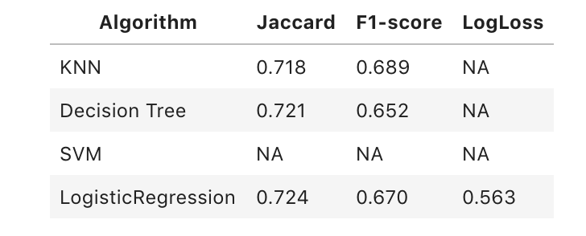
Model Evaluation
Train Set (80% of dataset size)
Test Set (20 % of dataset size)
KNN Classifier
Decision Tree Classifier
SVM Classifier
Logistic Regression
K = 8
Max depth = 4
Criterion = ‘Entropy’
Kernel = ‘rbf’
C=0.01
Solver='liblinear'
*
* SVM is highly inefficient on large data sets, hence didn’t run the model

Slide 14
Conclusion and Future Direction
Built useful models to classify the severity of the collision based on several data points
Logistic regression gave the best accuracy of all the model considered
Accuracy of the models can be improved
Multi-modal data inclusion will help the prediction more accurate
CCTV footage (image/video analysis)
Demographic data of the persons involved (age, sex, race, ethnicity etc.)

